Slide 1

The Impact of Focus and Context Visualization Techniques on Depth Perception in Optical See-Through Head-Mounted Displays
Date of Publication: 12 May 2021
Name :- Sreenath Reddy Kurukunda ID :- 811211580

Slide 2
Authors
Alejandro Martin-Gomez
Department of Informatics, Chair for Computer Aided Medical Procedures and Augmented Reality, Technical University of Munich, Munich, Germany
Jakob Weiss
Department of Informatics, Chair for Computer Aided Medical Procedures and Augmented Reality, Technical University of Munich, Munich, Germany
Andreas Keller
Department of Informatics, Chair for Computer Aided Medical Procedures and Augmented Reality, Technical University of Munich, Munich, Germany

Slide 3
Ulrich Eck
Department of Informatics, Chair for Computer Aided Medical Procedures and Augmented Reality, Technical University of Munich, Munich, Germany
Daniel Roth
FAU Erlangen-Nürnberg, Erlangen, Germany
Nassir Navab
Department of Informatics, Chair for Computer Aided Medical Procedures and Augmented Reality, Technical University of Munich, Munich, Germany
Laboratory for Computer Aided Medical Procedures, Whiting School of Engineering, Johns Hopkins University, Baltimore, MD, USA

Slide 4
Introduction
The use of focus and context visualization techniques to facilitate the presentation of hidden components located inside solid opaque objects has previously been extensively researched. Cutaways, cross-sections, exploded views, and ghosting are examples of such techniques.Such techniques aim to promote a more intuitive understanding of the object's construction or composition, in addition to providing cues to visualize hidden content. In the context of augmented reality, F+C visualizations refer to techniques that enhance the visualization of a high-interest augmented object and use additional cues to present and ground the augmented object within the real scene. This grounding effect is especially important when visualizing objects beneath real-world surfaces, as is required in medical scenarios. Understanding the complex geometry of anatomical structures in neurosurgical interventions, as well as visualizing registered ultrasound imagery in-situ via the generation of virtual windows, is critical in this field.A virtual exploded view can be seamlessly visualized within the context of a real object in industrial scenarios to aid understanding of spatial relations.

Slide 5
The strongest depth cue in all spaces is occlusion. Binocular disparities and motion parallax provide strong information in the personal space and their effectiveness decreases in function of the distance. In addition, convergence and accommodation provide useful information in personal space.
providing credible occlusion information represents a key requirement for AR applications that demand the visualization of augmented content behind the surface of real objects. Failing to provide appropriate additional cues could lead to the augmented content being perceived in front of the real object even when other cues like binocular disparities or motion parallax would suggest otherwise

Slide 6
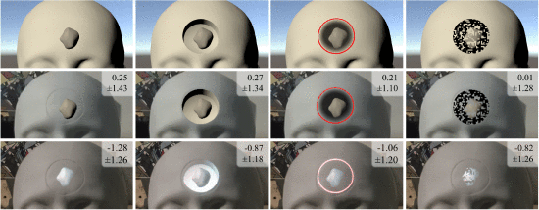
Base implementations of focus and context visualization techniques (top row) and their appearance in video- (mid row), and optical- (bottom row) see-through head-mounted displays. From left to right: Baseline overlay without contextual layer, Virtual Window, Contextual Anatomical Mimesis, and Virtual Mask. Mean and standard deviation of corresponding alignment errors of study 1 are presented in centimeters. The OST images are captured using a smartphone camera placed at the eye position. Contrast and brightness have been adjusted for a faithful impression of the overlay as observed by the user.

Slide 7
The first work that investigates how depth perception in in-situ visualization is affected by the additive displays commonly used in OST HMDs. propose to decompose existing visualization techniques into different visual properties to provide a useful framework for further exploring the design space of F+C techniques for in-situ visualization in AR.
Furthermore, we propose the use of chromatic shadows and hatching techniques to overcome the limited contrast and occlusion of OST displays. These two concepts were previously discussed in volume visualization and illustrative rendering
While F+C visualization techniques can produce the visual effect required to improve the perception of augmented content inside of a real object, for example by generating a virtual hole over its surface, they are dependent on the augmentation to fully block the real content to provide consistent occlusion cues.
These visualization techniques have been extensively explored for screen-based AR systems such as hand-held devices or VST HMDs as they can effectively render the fully opaque dark colors required for the desired visualization. \

Slide 8
Focus and Context Techniques in AR
Manifold techniques have been presented for F+C visualization. However, most of these techniques were developed using VST HMDs and rely on creating the illusion of virtual cutaway of the real surface.
Three F+C visualizations
the virtual window
contextual anatomic mimesis
the virtual mask

Slide 9
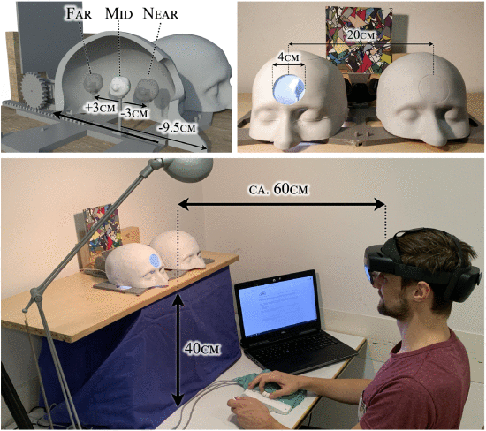
Apparatus

Slide 10
Improving F+C for OST HMDs
First, the inability to render opaque black in an additive display affects the visual outcome when compared to VST, most strongly changing how Contextual Anatomic Mimesis and Virtual Mask manifest. Second, the contrast of the display reduces visibility of shading details, for example within the interior surface of Virtual Window.
The disappearing dark regions can be mitigated by compressing the intensity range, mapping black to gray. These gray areas provide a better border between non-augmented regions and areas which are augmented but black.
observe that regions with low luminance still appear translucent because the real world is visible behind the augmentation, whereas very bright overlay regions appear solid. To exploit this effect, propose the use of hatching. techniques commonly employed in illustrative rendering.

Slide 11
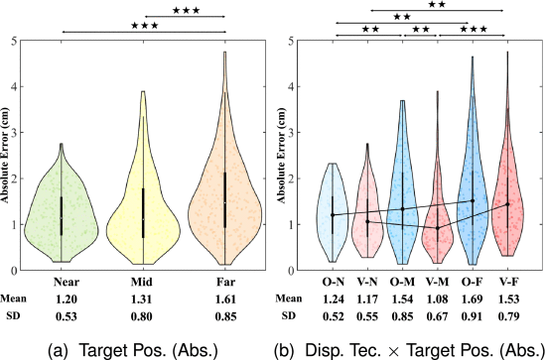
Alignment Error
These results were corroborated by a main effect for Target Position; F(1.41,43.73)=26.6, p<.001, η2p=.462. Consecutive pairwise comparisons showed that the Far position evoked the largest absolute alignment error, significantly larger than both other positions (ps<.001).

Slide 12
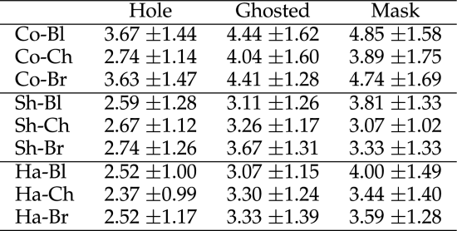
Moreover, significant interactions for InteriorRendering×ShadowRepresentation; F(4,104)=3.87, p=.006, η2p=.130 were found. Main effects for InteriorRendering; F(2,52)=19.33, p<.001, η2p=.351, revealed that users found it easier to complete alignment when using the hatched (M=3.13, SD=1.35) and shaded (M=3.14, SD=1.30) rendering compared with the constant (M=4.05, SD=1.64; p<.001).

Slide 13
Visual Attractiveness. Results obtained after analysing the participants’ opinion regarding visual attractiveness showed significant interaction for InteriorRendering×ShadowRepresentation; F(4,104)=4.46, p=.002, η2p=.146. A main effect for InteriorRendering revealed that participants found the shaded (M=3.35, SD=1.54; p<.001) and the hatched (M=3.45, SD=1.50; p=.004) renderings more visually appealing than the constant (M=4.17, SD=1.63).
Moreover, test revealed a strong significant main effect for ExteriorVisualization; F(2,52)=27.06, p<.001, η2p=.510. Posterior pairwise comparisons showed that participants found the mask (M=4.30, SD=1.59) less visually appealing than the ghosted (M=3.73, SD=1.49; p=.005) and the hole (M=2.95, SD=1.41; p<.001), as well as the ghosted than the hole (p<.001).

Slide 14
In terms of ExteriorVisualization, have found that mask performs badly for error measures as well as both subjective (usability related) metrics. Even the combinations which add a brighter background cannot improve on the error metrics, and the subjective metrics show the same behavior. The hole and ghosted perform similarly for error metrics, however participants seem to prefer hole visualizations over using ghosted techniques.

Slide 15
Conclusion
Developing techniques for in-situ visualization is often guided by a specific application case with unique constraints. The conceptual decomposition of F+C visualization techniques presented in this work can be used to explore the design space of such AR visualizations for both OST and VST technologies, potentially adding new variants or novel dimensions to the proposed scheme.
In this regard, believe that users benefit from the adaptation of visualization techniques designed to provide optimal visual cues for specific tasks not only in the context of medical applications, but also for various near-field AR approaches that require the in-situ visualization of structures within real objects.

Slide 16
Thank you

